Slide 1
Regenerative Agriculture Gotta Do It Now!
David Rourke, Minto, Manitoba
drsrourke@gmail.com

Slide 2
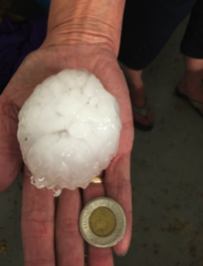
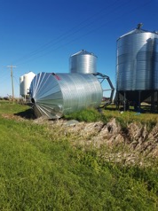
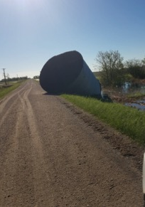
Need for Change
Paris Accord
Pope Francis
UN IPCC SR15
Increase in extreme events

Slide 3
The Temperature is Rising!
NOAA temperature change; Prairie Climate Centre

Slide 4
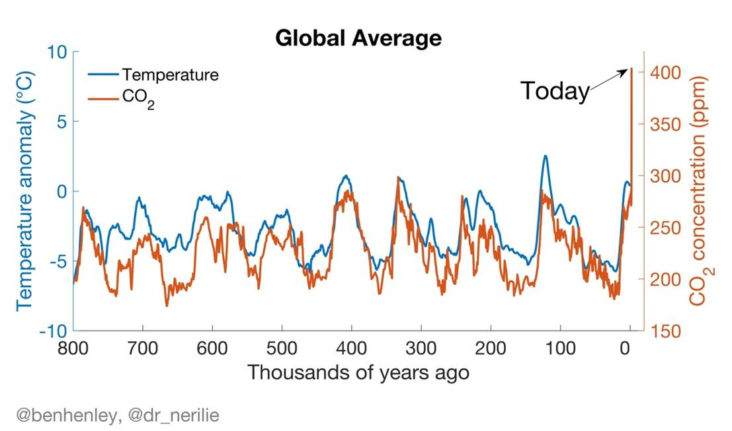
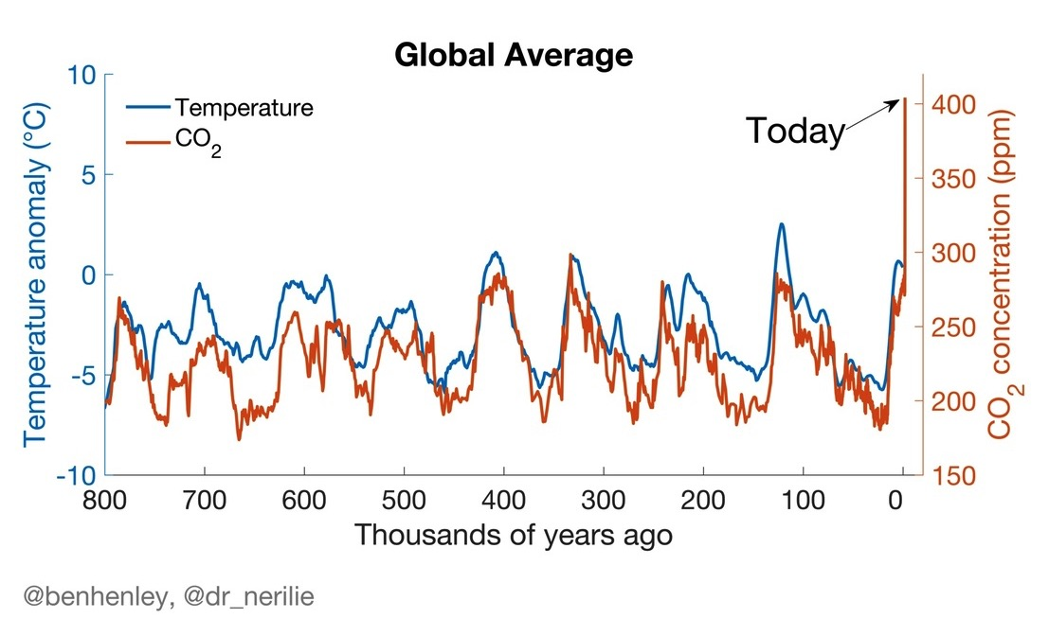
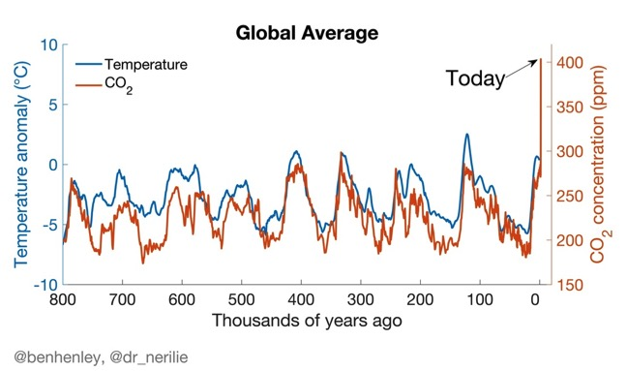
Temperature and CO₂ over the last 800,000 years

Slide 5
World Weather-Related Natural Catastrophes (1981-2017)

Slide 6
Recognize the Solutions
Reduce fossil fuel use by 45% by 2030 and 100% by 2050
Put the excess CO₂ back in storage
Land management
4 in 1,000 program
Increase in soil organic matter from 3% to 4.8%
Zero till farmers in Manitoba ≈ 2.5 in 1,000
Rodale in P.A. ≈ 2 to 4 in 1,000

Slide 7
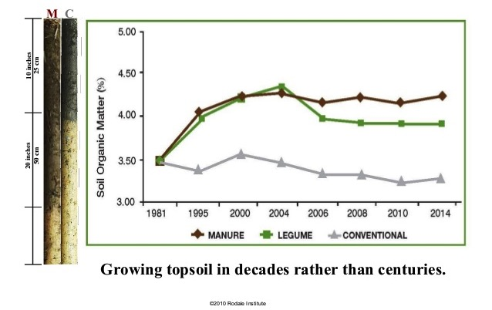
Long Term Study – Rodale Institute Pennsylvania

Slide 8
Need to Evolve Farm Practices
Deficiencies in soil organic matter
Weak soil food web
Inability to use water or rain where it falls
Poor infiltration and water storage
Utilizing a lot of outside energy
Fossil fuels, including natural gas used for production of anhydrous ammonia
Approximately 0.5 ton of carbon dioxide equivalent for every acre of zero-till wheat
0.7 tons of carbon dioxide equivalent for every acre of zero-till canola
Buildup of hard to control weeds and herbicide resistant weeds
Buildup of hard to control insects and insecticide resistant pests
Buildup of hard to control diseases and fungicide resistant diseases

Slide 9
Need to Evolve Farm Practices cont.
Decline in the nutrient density of crops
Susceptible to the effects of large rains and droughts
Large risk to crop insurance and taxpayers and eventually consumers
Large contributor to downstream flooding and nutrient release
Large loss of biodiversity including beneficial insects and birds
Increasing destruction of some of my best soils through salinity seep
Soil erosion although it is less than it was in the first hundred years
Net loss of nutrients, especially phosphorus off the farm
Loss of trust from consumers
MOVING FROM BEING
PART OF THE PROBLEM
BE PART OF THE SOLUTION

Slide 10
Rourke Farms Ltd.
Made the decision in 2016 to go to Regenerative Organic.
Organic production, harvest 2019
Regenerative – a little longer

Slide 11
Goals
The objectives for my farm include:
Generate 4 times more profit than my past zero till practices
Sequester carbon 2-3 times faster
Produce as much food/acre
Reduce fossil fuels by UN IPCC targets or at least 95% in 20 years.
Produce higher nutrient dense food as soil health increases

Slide 12
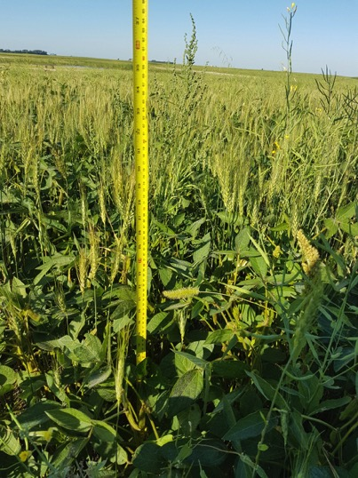
Changes on the Farm
Change thinking
CHECKERS CHESS

Slide 13
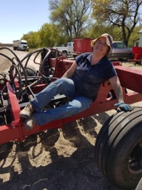
Staffing and Advisors
My wife Diane, CFO
2 full time Farm Employees
2 seasonal Employees
Dorian, John & Stella & other family members
Haylee – traffic coordinator
Often we are one less than we need
Stuart McMillan – Organic Certification Specialist
Organic certification body - OPAM
Organic Farm Club/Katherine Stanley and the U of M Natural Farming Systems
Lots of networking
Tours and seminars

Slide 14
Labour and Equipment

Slide 15
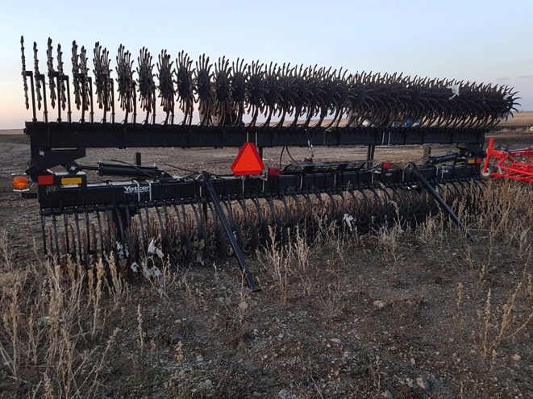
Changing Equipment

Slide 16
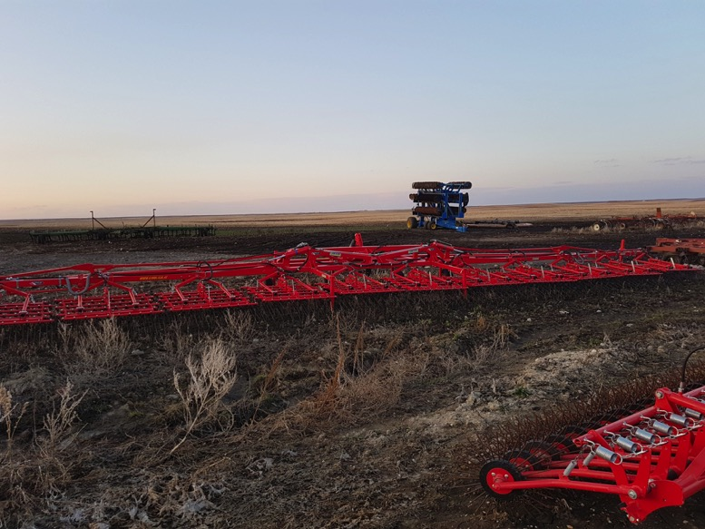

Slide 17
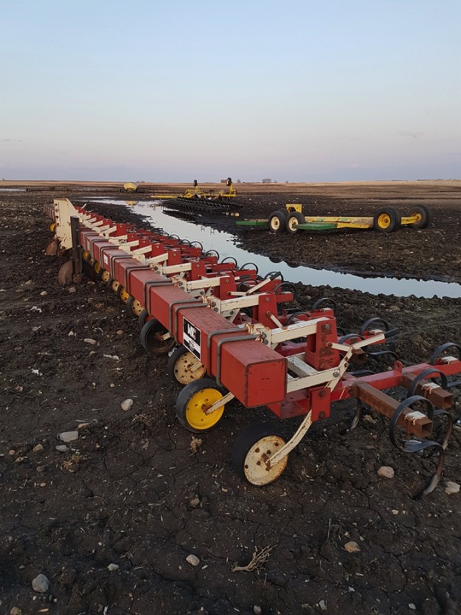

Slide 18
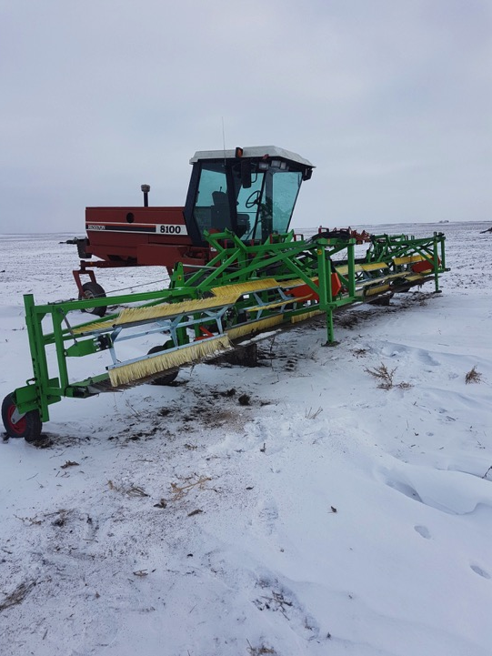

Slide 19
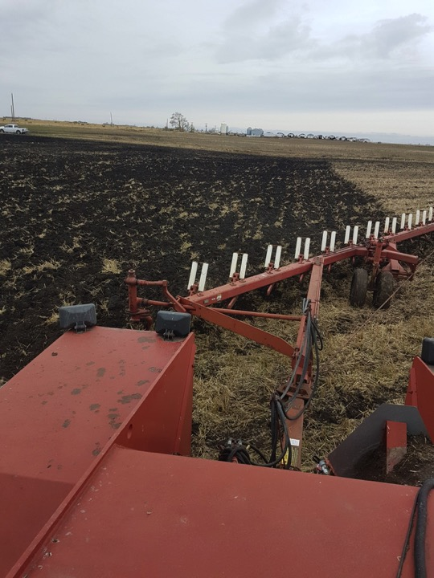

Slide 21
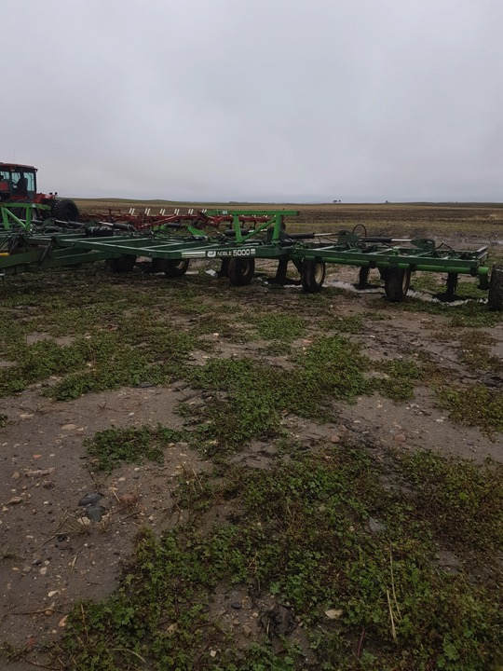

Slide 22
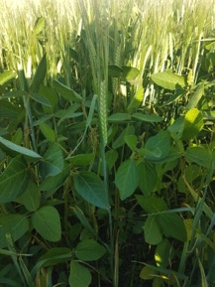
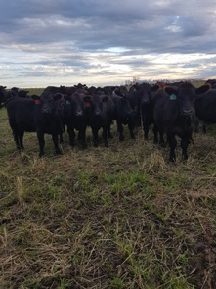
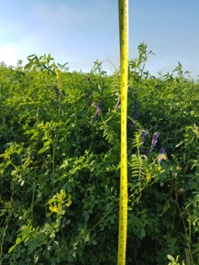
More Changes
Farming practices
Rotations
More species
Crop varieties
Intercrop
Green manure crops
Relay crops
Companion crops
Armour
Living roots
Diverse species
Reduce tillage
Integrate cattle

Slide 23
Crop Rotation
1st
Green Manure
Sweet clover, vetch, annual clover, alfalfa, fababeans, soybeans
Wheat -Hemp - Flax
Pea/Oat/Mustard or Soybean/Flax
Chickpeas/Flax
Dry Beans
Under seeded to subterranean clover, etc.
Oats with clover & vetch
No Till Organic
With Roller Blade
Cattle Grazing
(early, mid, late)
Phosphorus Source
Plow & Seed
Next crop
4th
2nd
Fall rye or triticale, hairy vetch and red clover
Next crop
3rd

Slide 24
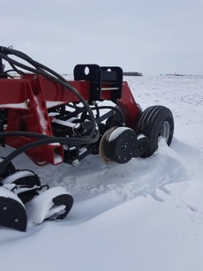
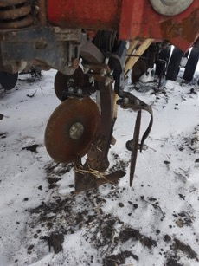
Progress
One step back – hopefully two forward
The secret is having enough seeding capacity
Eventually replace tillage with plants and biology

Slide 25
2018 Yields
Barley yields 60-140 bushels/ac. commercial production
Variety trials

Slide 26
2018 Yields
Wheat yields 40-50 bu/ac commercial production
Wheat variety trials

Slide 27
2018 Yields
Intercrop trial yields

Slide 28
2018 Yields

Slide 29
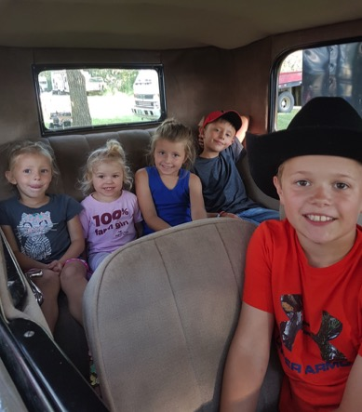
Conclusion
We need leadership and innovation to move us forward to ensure a good future for descendants.
Gotta Do It Now!
Notes:
200 years ago my Great, great, great, grandfather, James Thomas Rourke and Margaret Abrams made a decision to leave Ireland and homestead at Valcartier, Quebec. That decision has had a positive effect on my life every day.
With global warming having dramatic impacts on us already @1ºC and forecast to get much worse, what decisions are we going to make today for which our descendants will be thankful.

Slide 30
